Slide 1
V2.7.0
New Features and Process

Slide 2
Enhancements
In V2.7.0 we have added:
Searching for customers by email address
Searching for invoices by item description
Trade-In Report

Slide 3
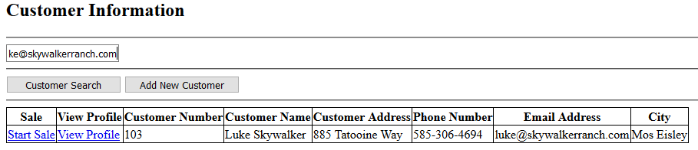
Searching For Customers By Email Address
In the customer search bar, you can enter either a full or partial email address to return results.

Slide 4
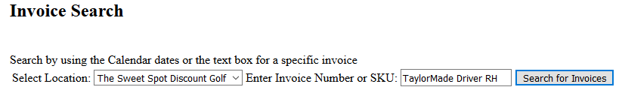
Searching For Invoices By Item Description
Instead of entering an invoice number or sku, you can now enter an item description to search for all invoices that have that item on them.

Slide 5
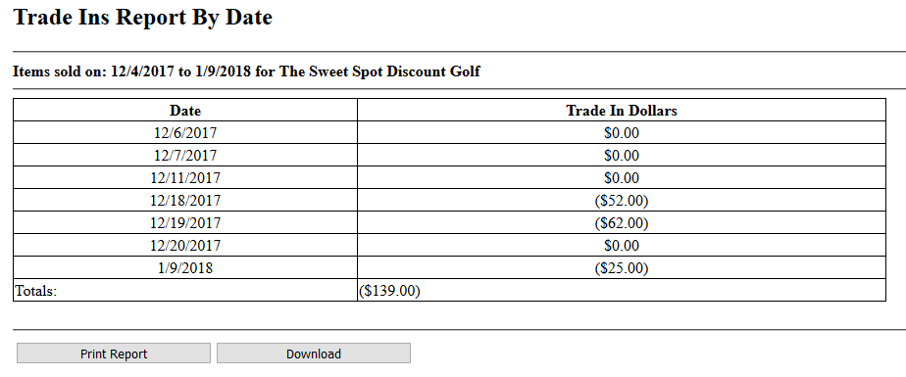
Trade-In Report
The Trade-In report shows the total dollar amount of trade-ins for each day between the selected dates.

